Slide 1

Department of Computer Science
BSc (Hons) Computer Science
Academic Year 2024/2025
Machine Learning model For Predicting House Rent Prices in Ibadan: A data driven approach
Rotimi Israel Taye
E047849
Supervisor: Mr Abiola

Slide 2
Background of the Study
Housing Rent in Nigeria: Rent is a periodic payment by a tenant to a landlord for the occupation of a property (Onyejiaka et al., 2025). In Ibadan, rent prices vary widely due to location, infrastructure, and property type.
Limitations of Traditional Valuation: Conventional methods rely on agent judgment and limited market data, leading to inconsistent, subjective, and time-consuming valuations.
Machine Learning in Real Estate: ML algorithms, particularly regression-based models, have demonstrated high accuracy in housing price prediction tasks globally (Smith et al., 2024).
Linear Regression: Models the relationship between a dependent variable (rent price) and independent variables (location, size, amenities, etc.), making it interpretable and computationally efficient.
Gap Identified: No data-driven rent prediction tool exists specifically for the Ibadan housing market, motivating a localized ML solution.

Slide 3
Related Works
S/N | Title / Authors / Year | Methodology | Major Results | Observed Weakness
1 | Integrating Random Forest and XGBoost For Accurate House Rent Prediction — Singh et al. (2025) | Ensemble ML: Random Forest + XGBoost; regression on rental factors (location, sq ft, amenities) | High accuracy; combined model outperformed individual baselines; location and structural features as key predictors | High computational cost; potential overfitting; dataset-dependent
2 | Real Estate Decision-Making: Price Prediction via Advanced ML Algorithms — Shbool et al. (2025) | SVR and Gradient Boosting Machine (GBM) | Reduced bias vs. traditional methods; high accuracy in valuation | Focused on Amman region; may need adaptation for other markets
3 | Enhancing House Price Forecasting with Hybrid Data-Driven Feature Extraction — Soon et al. (2025) | Hybrid VMD-RF feature extraction + SVR/LSTM | High R² = 0.97; unified health index improves prediction | Relies on specific decomposition; complex hybrid setup
4 | An Exploratory Approach to Composite Modelling for Real Estate Assessment — Hermans et al. (2023) | Composite modelling (exploratory AVM synthesis) | Improved accuracy via model combination | Exploratory; needs broader validation
5 | A Survey of Methods and Input Data Types for House Price Prediction — Geerts et al. (2023) | Multiple ML regression: XGBoost, RF, SVR, MLP, MLR; hyperparameter tuning | XGBoost best performer; location, size, features identified as key | High computational cost; data quality sensitive
6 | Transparent House Price Prediction Framework Using Ensemble Learning and ANOVA — Hussain et al. (2025) | Ensemble ML (XGBR, RFR, CBR); Genetic Algorithm tuning; SHAP/LIME explainability | Categorical Boosting + GA: R² ≈ 0.9973; high interpretability | High complexity/training time; compute-heavy

Slide 4
Statement of Problem
Traditional housing price valuation methods are subjective, time-consuming, and inconsistent, relying heavily on human judgment and limited market data since there is no existing data-driven, ML-powered rent prediction system tailored specifically for the Ibadan housing market. Development of a data-driven rent prediction system using a Linear Regression model trained on historical Ibadan housing data, deployed as an interactive web application will be of help.

Slide 5
AIM AND OBJECTIVES
The aim is to develop a Linear Regression model for predicting house rent prices in Ibadan.
The objectives of this project are:
Data preprocessing and feature engineering
For predicting house rent using relevant housing features through machine learning model.
To evaluate the performance and effectiveness of the developed linear regression model using appropriate statistical metrics

Slide 6
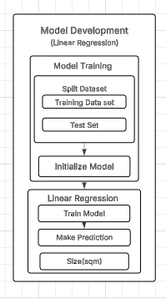
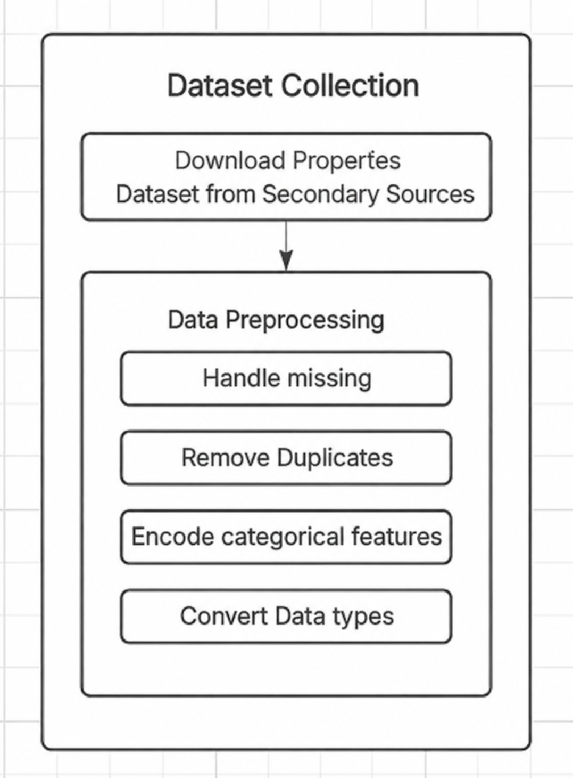
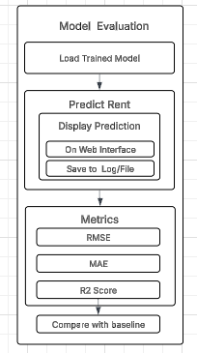
Methodology
Data collection and
preprocessing
Model Development
Model Evaluation

Slide 7
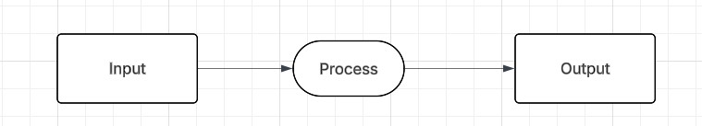
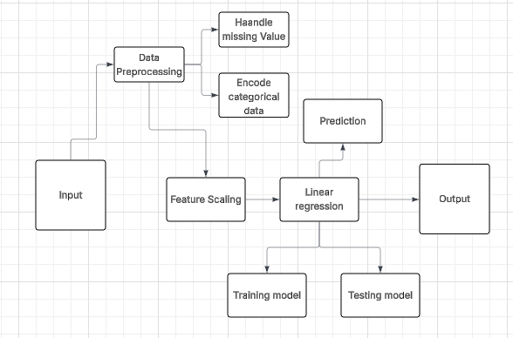
Data Flow Diagram
Level 0
Level 1

Slide 8
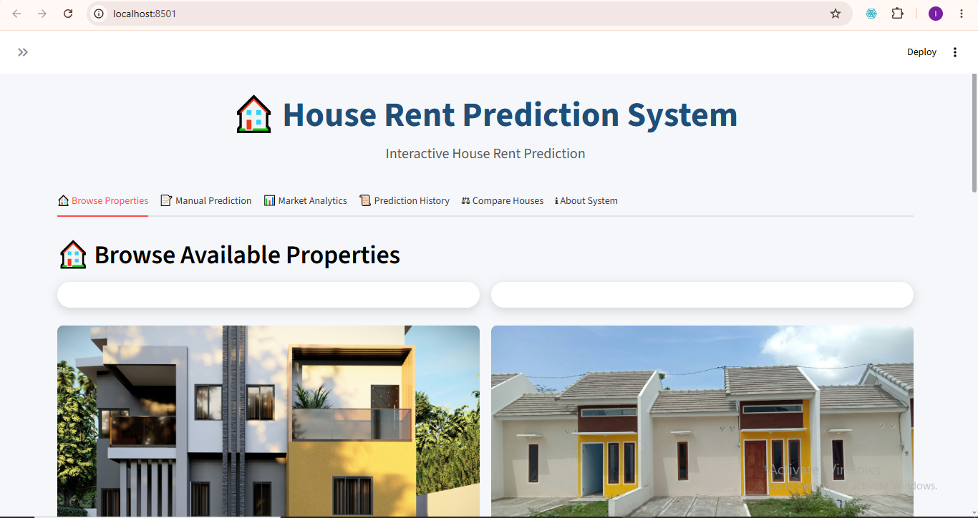
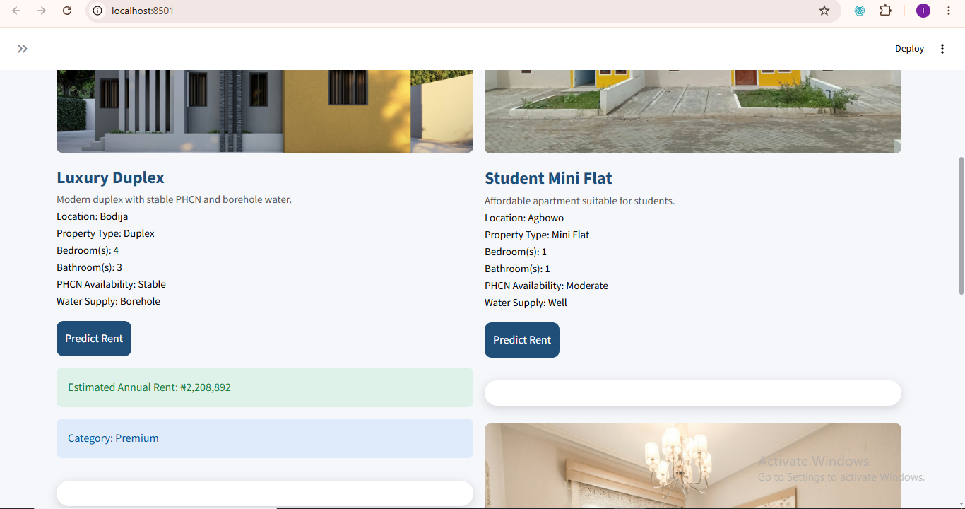
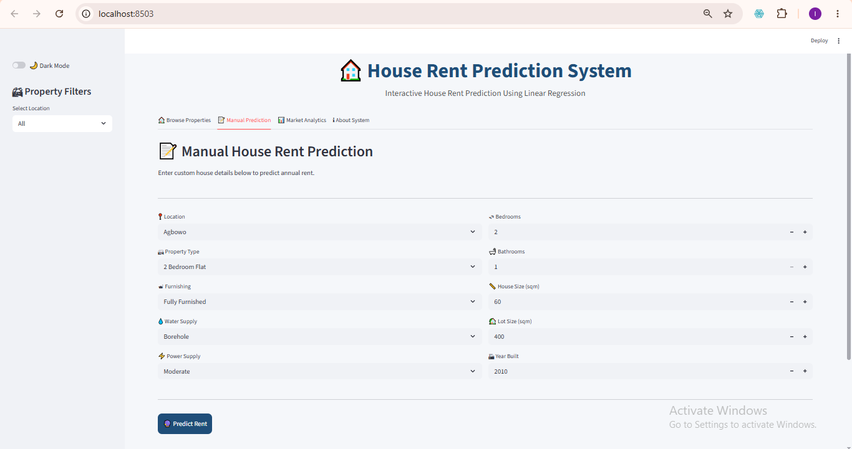
System Interface – Home & Manual Prediction
Property Gallery Interface
Home Interface (Browse Properties)
Manual Prediction Interface

Slide 9
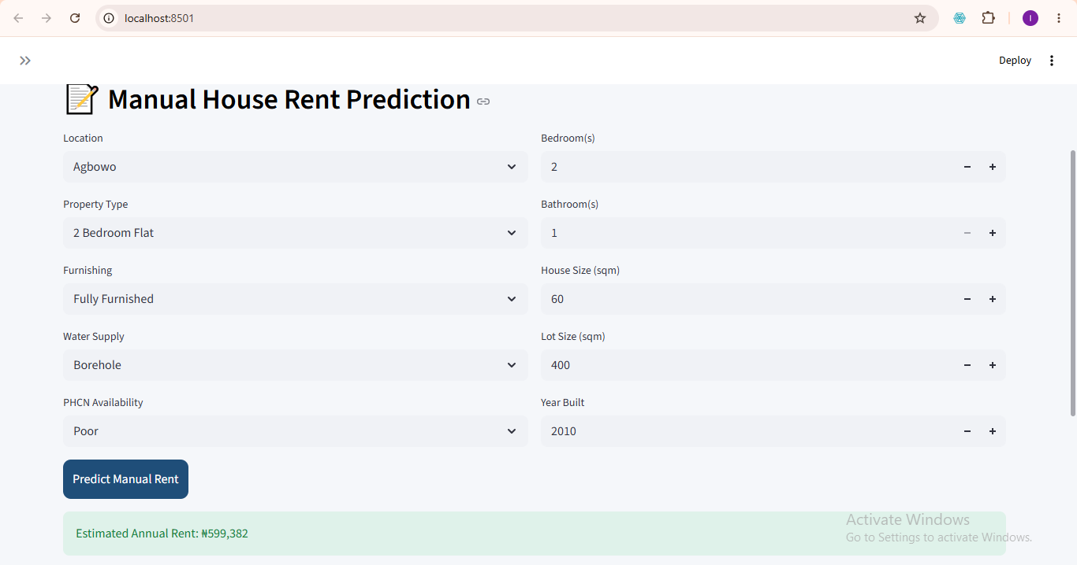
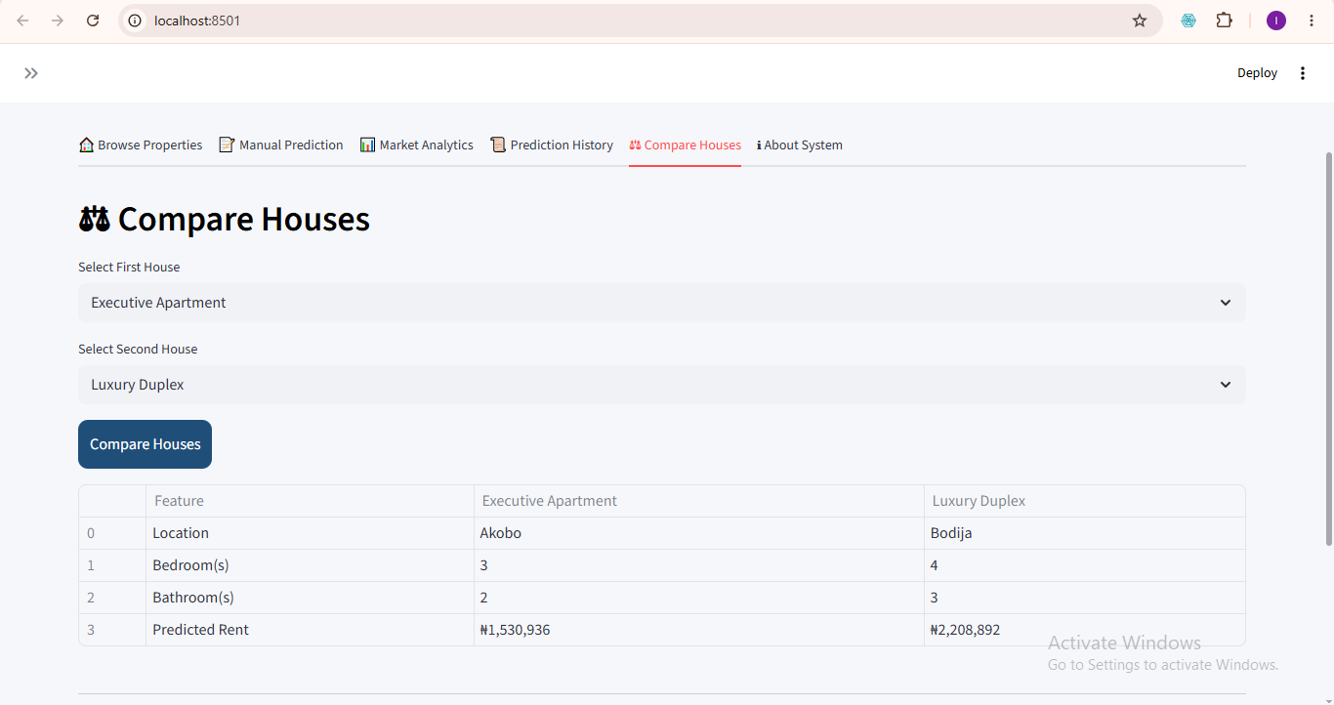
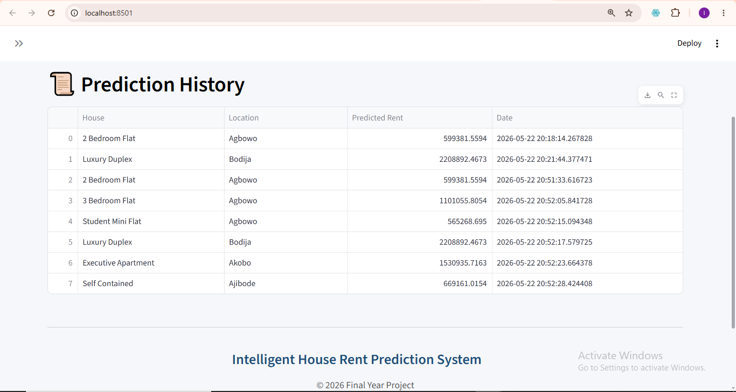
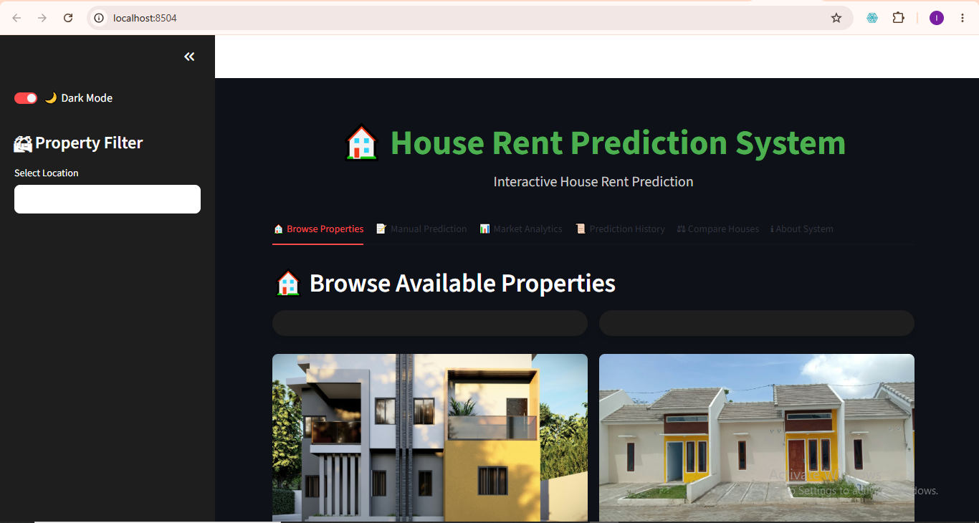
System Interface – Property Gallery, Comparison & History
Manual Prediction Output
House Comparison Interface
Prediction History Interface
Dark Mode Interface

Slide 10
Conclusion
In conclusion the data was gotten mainly for Ibadan and preprocessing was done, the model was built using linear regression, K-fold was used and there was model evaluation and an interactive streamlit user interface.

Slide 11
References
Onyejiaka, J. C., Onyima, C. N., & Okafor, J. I. (2025). Examination of factors that lead to rent default on selected residential properties in Awka, Anambra State. International Journal of Real Estate, 1(1), 65–79.
Smith, J. A., Brown, L. M., & Lee, R. K. (2024). Applying linear regression to housing rent determinants. Journal of Housing Economics, 12(3), 45–60. https://doi.org/10.1234/jhe.2024.009
Singh, H. V., Srivastava, S. K., Pandey, N. K., & Kumar, N. (2025). Integrating Random Forest and XGBoost for accurate house rent prediction. In 2025 International Conference on Proceedings. IEEE. https://doi.org/10.1109/...
Shbool, M. A., et al. (2025). Real estate decision-making: Precision in price prediction through advanced machine learning algorithms. International Journal of Housing Markets and Analysis. https://doi.org/10.1108/IJHMA-01-2025-0004
Soon, K. L., Soon, L. T., & Teo, J. Y. (2025). Enhancing house price forecasting with hybrid data driven feature extraction model. Journal of the Operational Research Society, 76(6), 1–12. https://doi.org/10.1080/01605682.2025.2513449
Hermans, L. D., McCord, M. J., Davis, P. T., & Bidanset, P. E. (2023). An exploratory approach to composite modelling for real estate assessment and accuracy. Journal of Property Tax Assessment & Administration, 20(1), 39–56.
Geerts, M., vanden Broucke, S., & De Weerdt, J. (2023). A survey of methods and input data types for house price prediction. ISPRS International Journal of Geo-Information, 12(5), 200. https://doi.org/10.3390/ijgi12050200
Hussain, M. I., et al. (2025). A transparent house price prediction framework using ensemble learning, genetic algorithm-based tuning, and ANOVA-based feature analysis. FinTech, 4(3), 33. https://doi.org/10.3390/fintech4030033

Slide 12
THANK YOU

